Slide 1
StudyNotes – Windows Virtualization Technology
Sudhansu Sekhar Sutar

Slide 2
Contents
Virtualization Basics
Windows VMM Arrangements
Microsoft VMM Product
Microsoft Hyper-V Architecture
Hyper-V System Requirements
Enable Virtualization Support
HAV Detection Tools
Detect HAV using Task Manager
Activate Hyper-V from Terminal
Activate Hyper-V from Desktop
Using Hyper-V
Launch Hyper-V Manager
Setup Virtual NW Switch
Create Virtual Machine
Supported Guest Operating Systems
Boot the Virtual Machine
Virtualization Market Share
References

Slide 3
Windows VMM Arrangements
Type-2 VMM
Hybrid VMM
Type-1 VMM (Hypervisor)
Guest 1
Guest 2
VMM
Guest 1
Guest 2
Guest 1
Guest 2
Host OS
Host OS
VMM
VMM
Hardware
Hardware
Hardware
Examples: JVM CLR
Examples: Virtual PC & Virtual Server
Examples: Windows Virtualization

Slide 4
Microsoft VMM Product
Virtual PC | Virtual Server | Hypervisor
Connectix Virtual PC | Connectix Virtual Server (Unreleased) | Microsoft Hyper-V Server (Free) 2008, 2008 R2, 2012, 2012 R2 2016, 2019
Microsoft Virtual PC 2004 | Microsoft Virtual Server 2005 | Windows Server 2008, 2008 R2, 2012, 2012 R2 2016, 2019
Microsoft Virtual PC 2007 | Microsoft Virtual Server 2005 R2 | Windows 8, 10 Professional
Windows Virtual PC ( Win 7) |  | Windows 8. 10 Enterprise

Slide 5
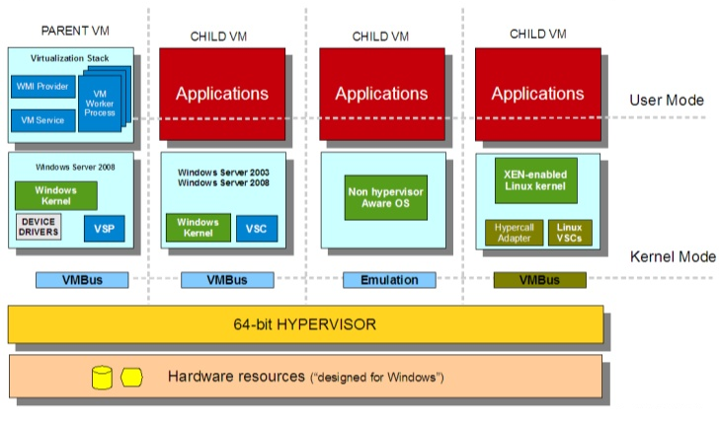
Microsoft Hyper-V Architecture

Slide 6
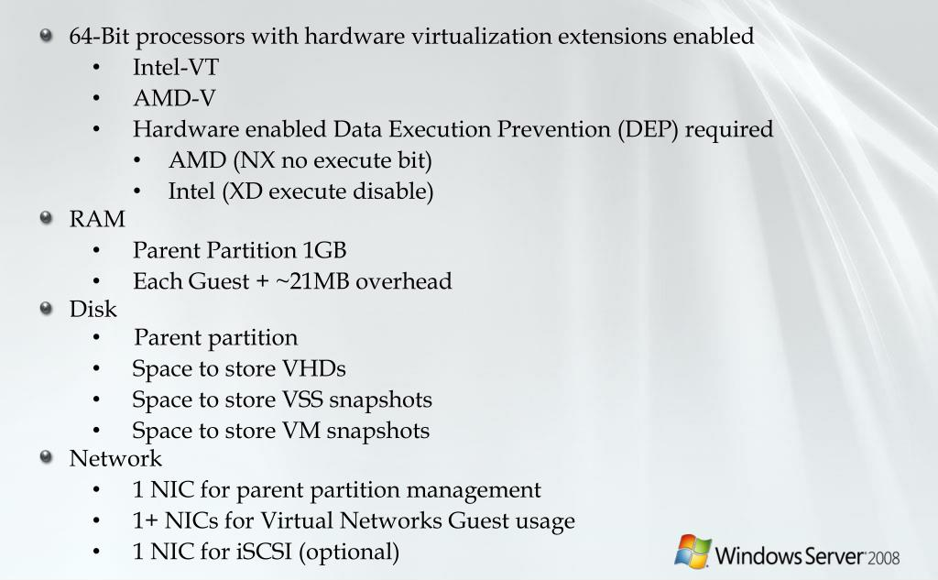
Hyper-V System Requirements

Slide 7
HAV Detection Tool
Tool | Vendor | File
HAV Detection Tool | Microsoft | havdetectiontool.exe (Win XP, Vista, 7)
Windows Task Manger | Microsoft | tskmgr.exe (Win 8, 8.1, 10)
Speccy | PiriForm | spsetup132.exe
SecurAble | GRC | securable.exe
Intel Processor Identification Utility | Intel | Intel(R) Processor Identification Utility.exe
AMD V Detection Utility | AMD | AMD-V_Hyper-V_Compatibility_Check_Utility.zip

Slide 8
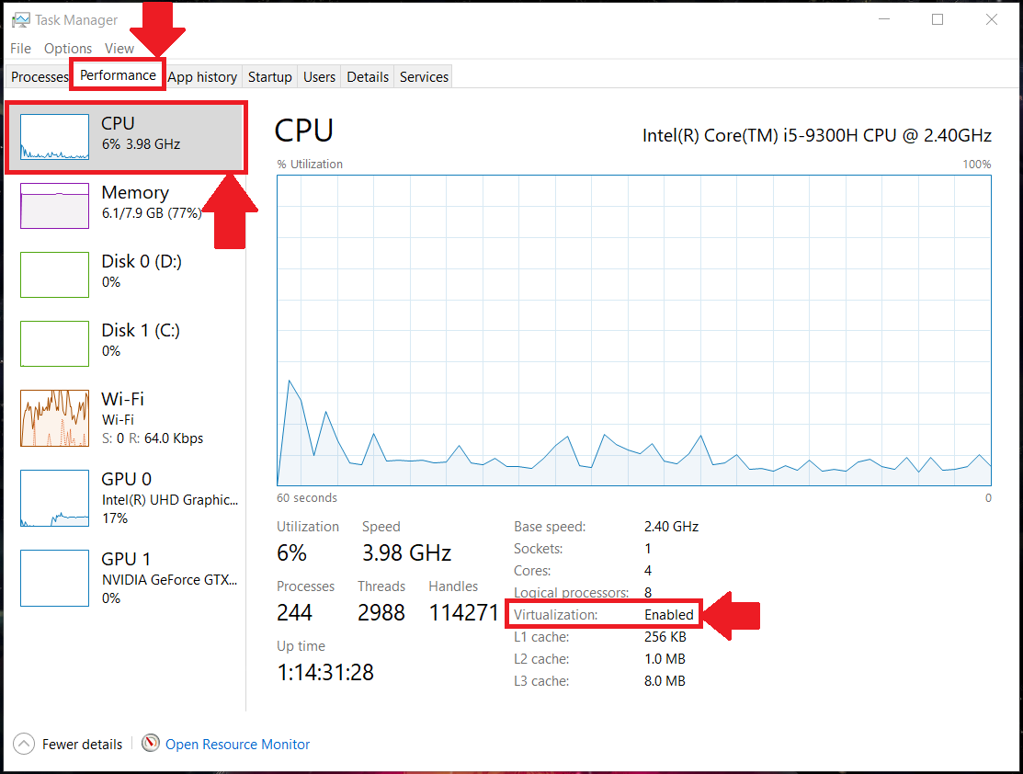
Detect HAV using Task Manager

Slide 9
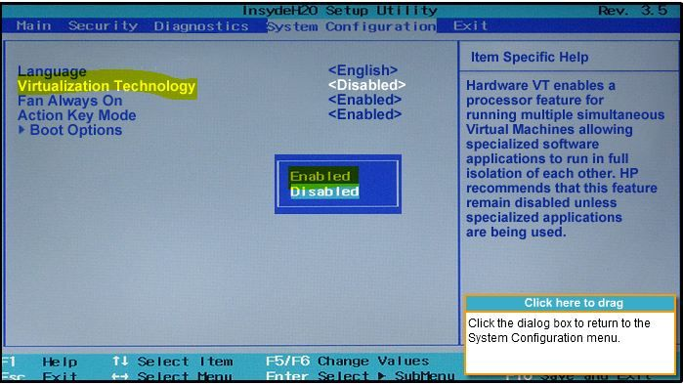
Enable HAV in the BIOS

Slide 10
Activate Hyper-V from Terminal
cmd.exe
>Dism /online /Enable-Feature /All /FeatureName:Microsoft-Hyper-V
Or
powershell.exe
>Enable-WindowsOptionalFeature -Online -FeatureName Microsoft-Hyper-V

Slide 11
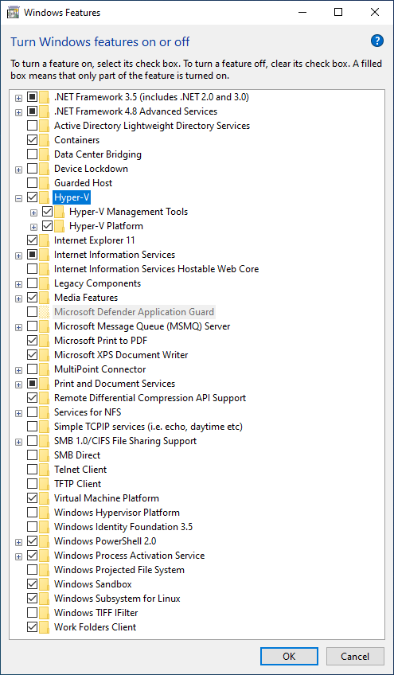
Activate Hyper-V from Desktop
1. Run
OptionalFeatures.exe
2. Select
Microsoft-Hyper-V

Slide 12
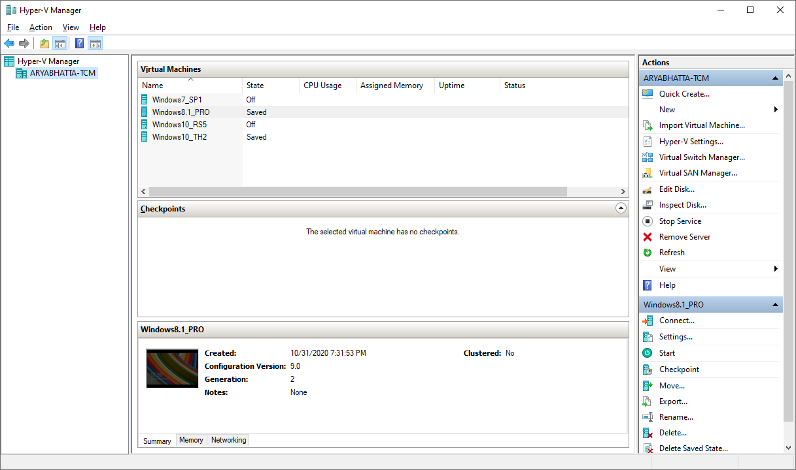
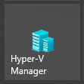
Launch Hyper-V Manager
Run Program

Slide 13
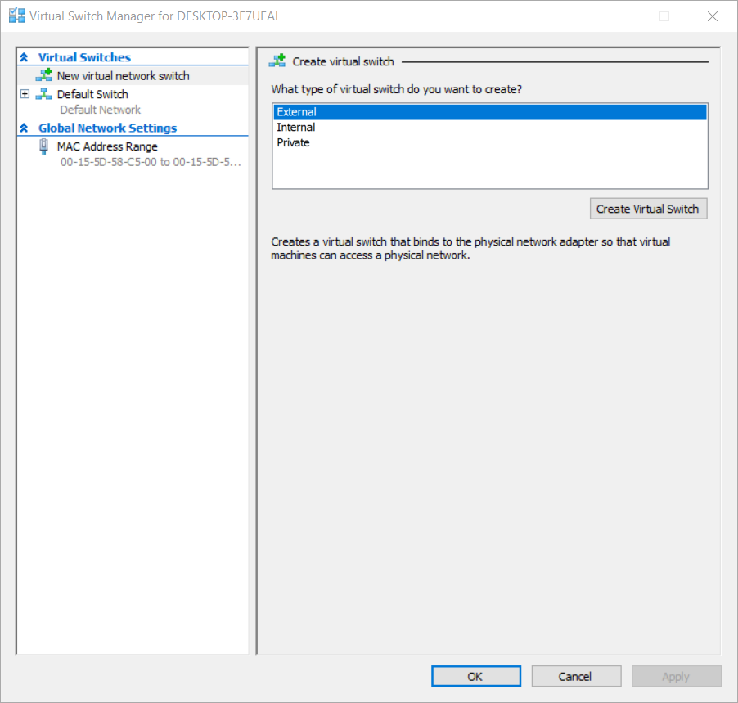
Setup Virtual Network Switch

Slide 14
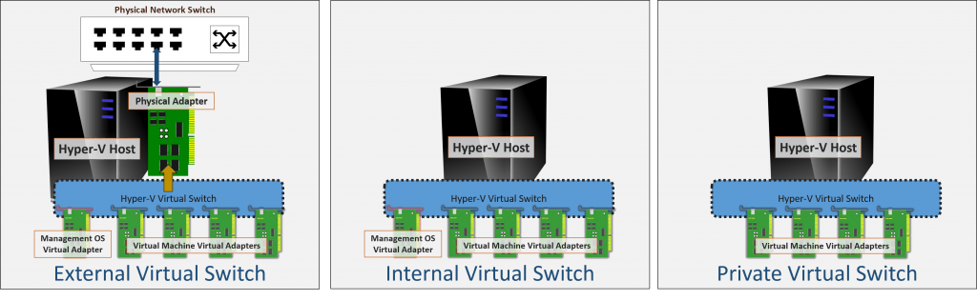
Virtual Network Switch Type
A Hyper-V virtual switch in external mode allows communications between virtual adapters connected to virtual machines and the management operating system. It uses single or teamed physical adapters to connect to a physical switch, thereby allowing communication switch other systems.
A Hyper-V virtual switch in internal mode allows communications only between virtual adapters connected to virtual machines and the management operating system.
A Hyper-V virtual switch in private mode allows communications only between virtual adapters connected to virtual machines.

Slide 15
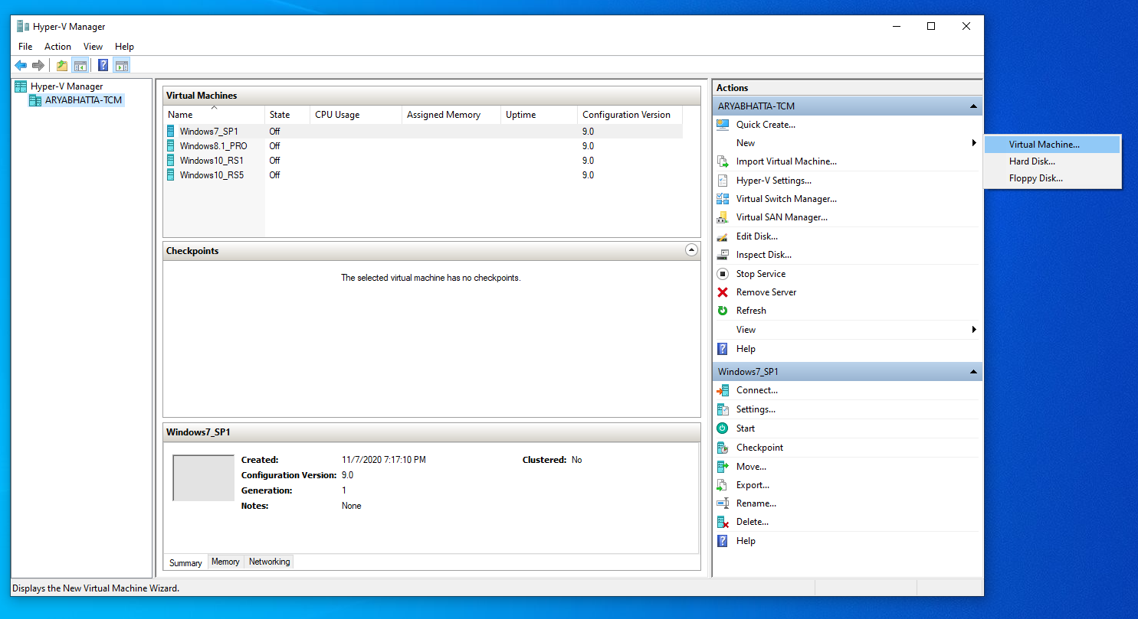
Create Virtual Machine

Slide 16
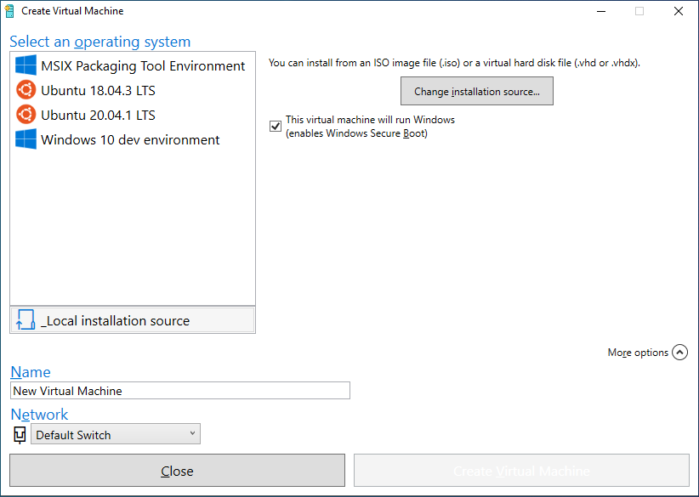
Quick Create Virtual Machine

Slide 17
Hyper-V Supported Guest Operating Systems Windows 2008 VER
Guest operating system |  | Virtual CPUs
OS | Editions | Number | Architecture
Windows Server 2012[a] | Hyper-V, Standard, Datacenter | 1–4 | x86-64
Windows Home Server 2011 | Standard | 1–4 | x86-64
Windows Server 2008 R2 SP1 | Web, Standard, Enterprise, Datacenter | 1–4 | x86-64
Windows Server 2008 SP2 | Web, Standard, Enterprise, Datacenter | 1–4 | IA-32, x86-64
Windows Server 2003 R2 SP2 | Web,[b] Standard, Enterprise, Datacenter | 1 or 2 | IA-32, x86-64
Windows 2000 SP4 | Professional, Server, Advanced Server | 1 | IA-32
Windows 7 | Professional, Enterprise, Ultimate | 1–4 | IA-32, x86-64
Windows Vista | Business, Enterprise, Ultimate | 1–4 | IA-32, x86-64
Windows XP SP3 | Professional | 1 or 2 | IA-32, x86-64
Windows XP SP2 | Professional, Professional x64 Edition | 1 | IA-32, x86-64
SUSE Linux Enterprise Server 10 SP4 or 11 SP1–SP3 | N/A | 1–4 | IA-32, x86-64
Red Hat Enterprise Linux 5.5–7.0 | Red Hat Compatible Kernel | 1–4 | IA-32, x86-64
CentOS 5.5–7.5 | N/A | 1–4 | IA-32, x86-64
Ubuntu 12.04–20.04 | Debian Compatible Kernel | 1–4 | IA-32, x86-64
Debian 7.0 | Debian Compatible Kernel | 1–4 | IA-32, x86-64
Oracle Linux 6.4 | Red Hat Compatible Kernel | 1–4 | IA-32, x86-64

Slide 18
Virtualization Market Share
Ranking | Technology | Market Share
1 | VMware vSphere | 13.92%
2 | Microsoft Hyper-V | 11.22%
3 | VMware ESX Server | 10.83%
4 | Citrix XenApp | 8.28%

Slide 19
References
https://www.cloudwards.net/hyper-v/
https://support.bluestacks.com/hc/en-us/articles/115003174386-How-can-I-enable-virtualization-VT-on-my-PC
https://social.technet.microsoft.com/wiki/contents/articles/585.the-microsoft-hardware-assisted-virtualization-detection-tool.aspx
https://www.tutorialspoint.com/windows10/windows10_virtualization.htm

Slide 20
END OF FILE

